Slide 1
Work Progress
By: Abdur Rehman

Slide 2
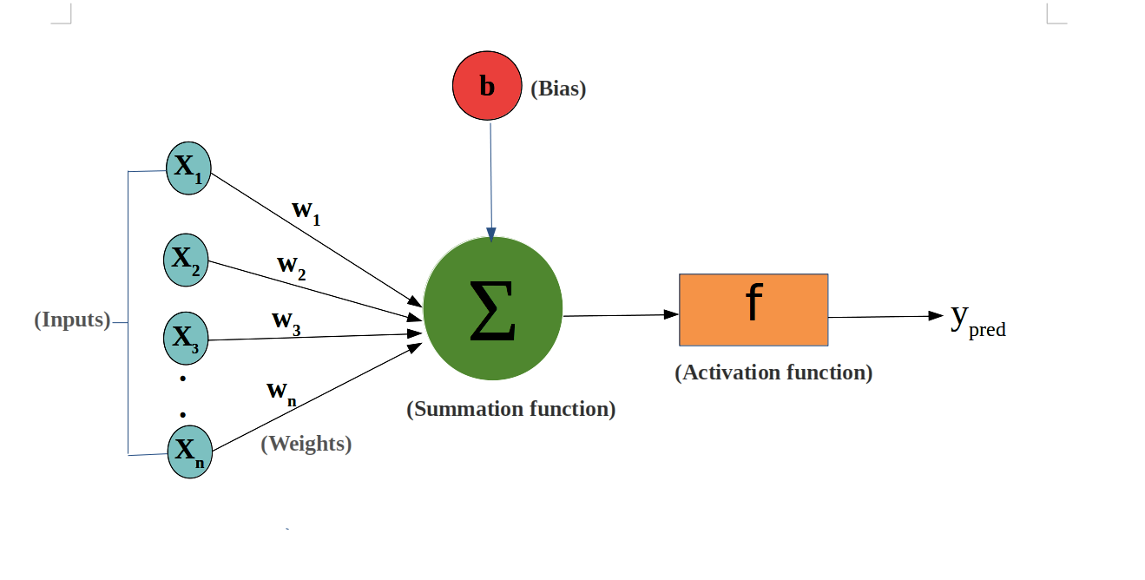
Regularizers in Keras
kernel_regularizer: Regularizer to apply a penalty on the layer's kernel
bias_regularizer: Regularizer to apply a penalty on the layer's bias
activity_regularizer: Regularizer to apply a penalty on the layer's output
Regression equation “y=Wx+b”;
where x is the input,
y is output,
W the weights matrix (also called kernel),
and b the bias.

Slide 3
L1 versus L2 regularization
The L1 regularization penalty is computed as:
loss = l1 * reduce_sum(abs(x))
The L2 regularization penalty is computed as:
loss = l2 * reduce_sum(square(x))

Slide 4
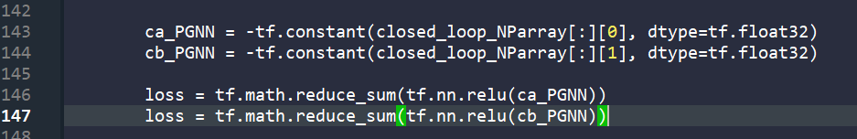
Physics Guided Neural Networks
The parameters used in the PGNN:
concentration of component 𝐴(𝑐𝐴)
concentration of component B(𝑐B)
Loss on Training Set: (<tf.Tensor: shape=(), dtype=float32, numpy=1.6433045>,
Loss on Testing Set: (<tf.Tensor: shape=(), dtype=float32, numpy=1.6433045>,

Slide 5
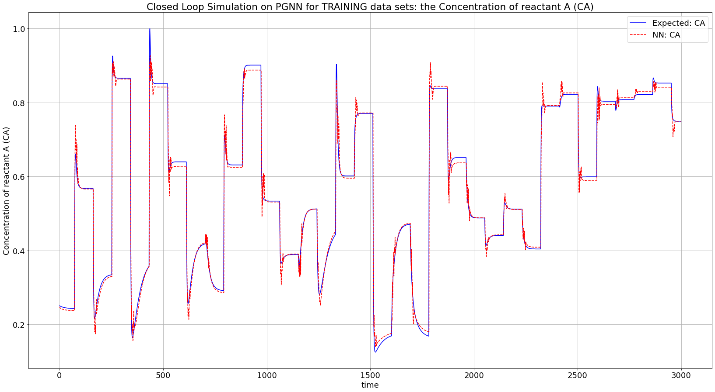

Slide 7
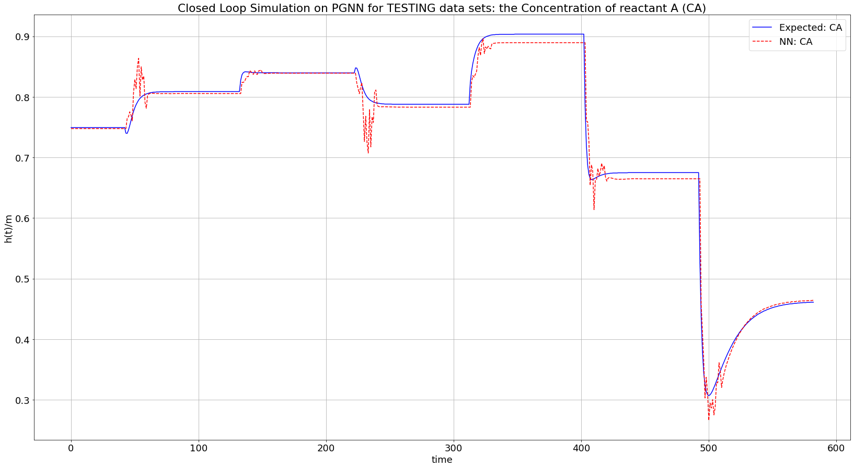

Slide 8
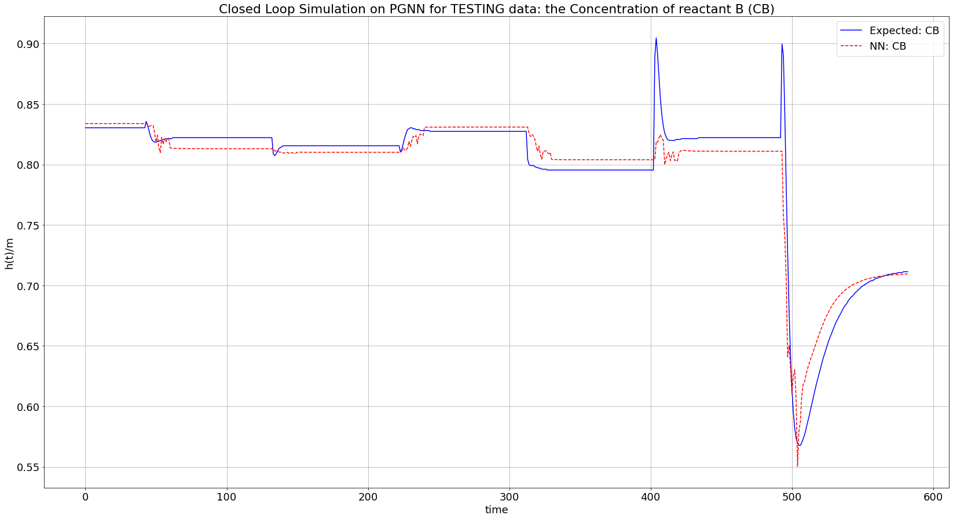

Slide 9
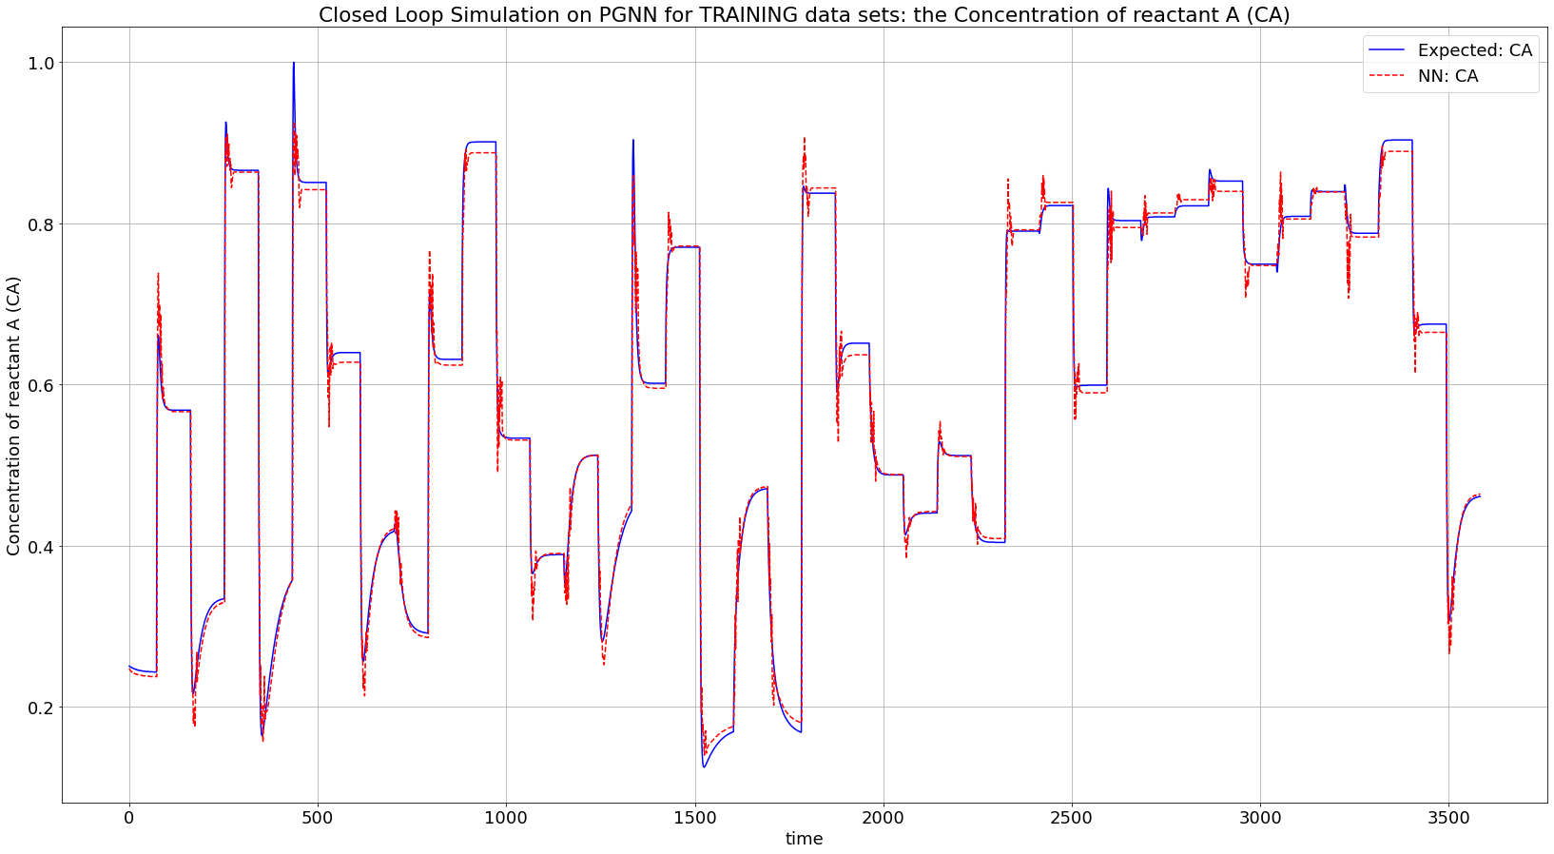

Slide 10
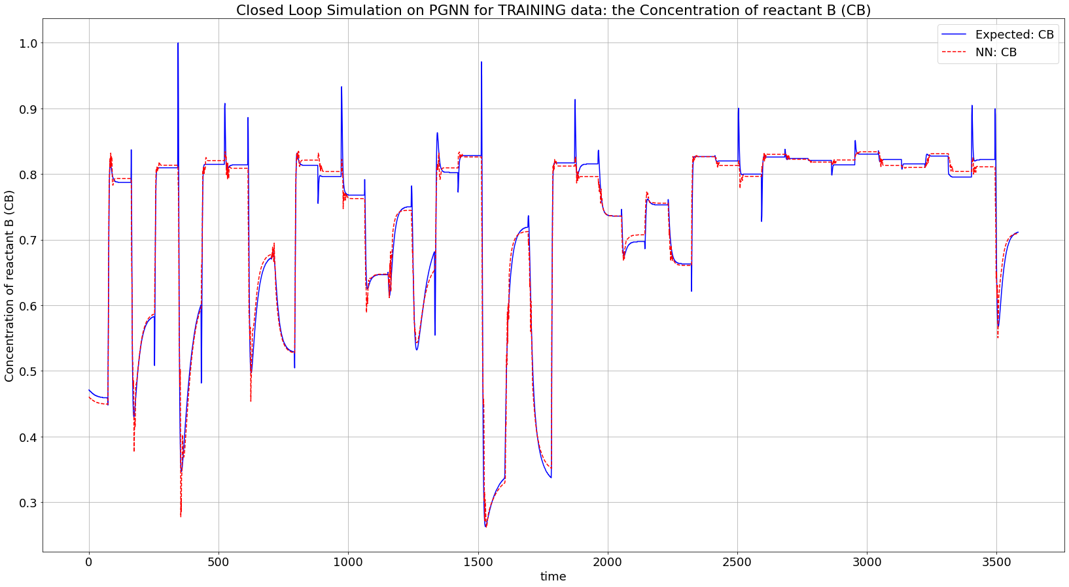

Slide 11
Time Taken On Different Steps in PGNN
Case | Time
Closed Loop Simulation (FOR LOOPS) | 500 – 800 ms
Single Loss Function | 20 – 30 ms
Single Epoch | 1000 – 1500 ms

